Slide 1
The Person Centered Plan
You have gotten the letter.
What now?

Slide 2
Orientation
You sit in a room (the old days) for hours and hours and end up on your phone because they lost you

Slide 3
Find someone to help you start
Yes, there’s a list. But…
Use your network
Ask around - other parents
Use that Facebook Group
Attend local SD advisory group meetings

Slide 4
Great! I’m Ready
Tell the Regional Center
(um.. more paperwork)
Request 12-month Expenditure Report
Start that “wish list” and go big
Start talking with FMS companies

Slide 5
The PCP Document the Cornerstone of Self Determination
Write a plan about your loved one.
Person Centered.
Always.
Pre-planning
PCP Meeting -
Who is Johnny, what makes him the most amazing person
What are his hopes and dreams?
What is important TO him, For him
Look at current supports – what is working, not working
Unmet needs – What is Johnny not getting that he needs
THESE ARE THINGS THAT ARE NORMALLY PROVIDED UNDER THE TRADITONAL SYSTEM
It bears repeating. THESE ARE THINGS THAT ARE NORMALLY PROVIDED UNDER THE TRADITONAL SYSTEM.
Change in circumstances – Covid
Goals and how to achieve them
Write the document, edit and when ready, submit it to your Regional Center coordinator. Request a budget meeting.

Slide 6
The Budget
You probably won’t have just one meeting.
Remember this is the hard part, but when everyone is in agreement, it is signed and considered certified.

Slide 7
The Spending Plan
Finally. The fun stuff.
Work off of your PCP document and the “wish list”
Bring in your FMS
Hiring people? Get those background checks. It can take up to a month and either you or the employee pay for it out of pocket
Do you want your IF to continue throughout the year?
Remember everything has to be inclusive.

Slide 8
Your spending plan is handed in and your Regional Center double checks for math errors, alignment with the PCP document, and inclusion Mysterious things happen in the background called UFS/Sandis and this is the process where your budget money is transferred to the FMS’s control. You work with the FMS to pay your people and services You have a final IPP to make sure everything has been covered. WARNING: DON’T SPEND MONEY AND EXPECT TO BE REIMBURSED.
Almost done!
The Handoff

Slide 9
Stuff happens. The beauty of this program is that it is not static, but changes with the person. You need to move money around? Can be done. Go live that best self-determined life!
You CAN change your mind.

Slide 10
Person Centered Planning Process
It’s about the person.
Always.

Slide 11
Checklist #1
Person Centered Planning
Source: Disability Voices United
Attend Orientation
Select PCP Planner or Independent Facilitator, and tell your Regional Center.
Conduct PrePlanning for your PCP Meeting
Hold a Person-Centered Planning Meeting
Develop a written Person-Centered Plan

Slide 12
Checklist #2
Individual Budget
Source: Disability Voices United
Get past 12-month expenditure report from your regional center
Meet with regional center about the budget
If appropriate, ask for a change in budget based on change in circumstances or unmet need
Once amount is agreed upon, regional center certifies the budget

Slide 13
Checklist #3
Services and
Spending Plan
Source: Disability Voices United
Identify services, staff and items to meet your goals
Write down all of the things that cost money, then think of who can pay for it (generic resources)
For those services that the SDP will pay for, figure out the costs and write them on your spending plan
Make sure all of your services are in settings that are inclusive
Make sure your services are on the list from DDS

Slide 14
Checklist #4
FMS and Staff
Source: Disability Voices United
Think about the model of FMS you want
Interview different FMS Providers
Select your FMS and inform your Regional Center
Interview service providers and staff you want to hire
After hiring staff ask FMS to conduct background checks
Sign contracts with all of your providers and give them to your FMS
If using the sole employer model, arrange for insurance and other requirements

Slide 15
Checklist #5
Your Individual Program Plan
(IPP)
Source: Disability Voices United
Schedule your IPP after you have your PCP and spending plan completed
Regional Center will verify that services meet guidelines for inclusive settings, generic resources and approved services
Regional attaches your spending plan and PCP to your IPP. The document is signed
Send your signed IPP and spending plan to your FMS
Make sure that regional center transfers the funds to the FMS

Slide 16
Checklist #6
Your Life in the Self- Determination Program
Source: Disability Voices United
Make sure to look at every monthly statement; If you are over your budget for that month, you should speak with your FMS
Hire an Independent Facilitator to help you after your PCP to find new staff, manage staff, find new activities and items (optional)
Tell the FMS if you change your staff or want to do something different that your spending plan
Update your PCP any time you need to, but at least once a year

Slide 17
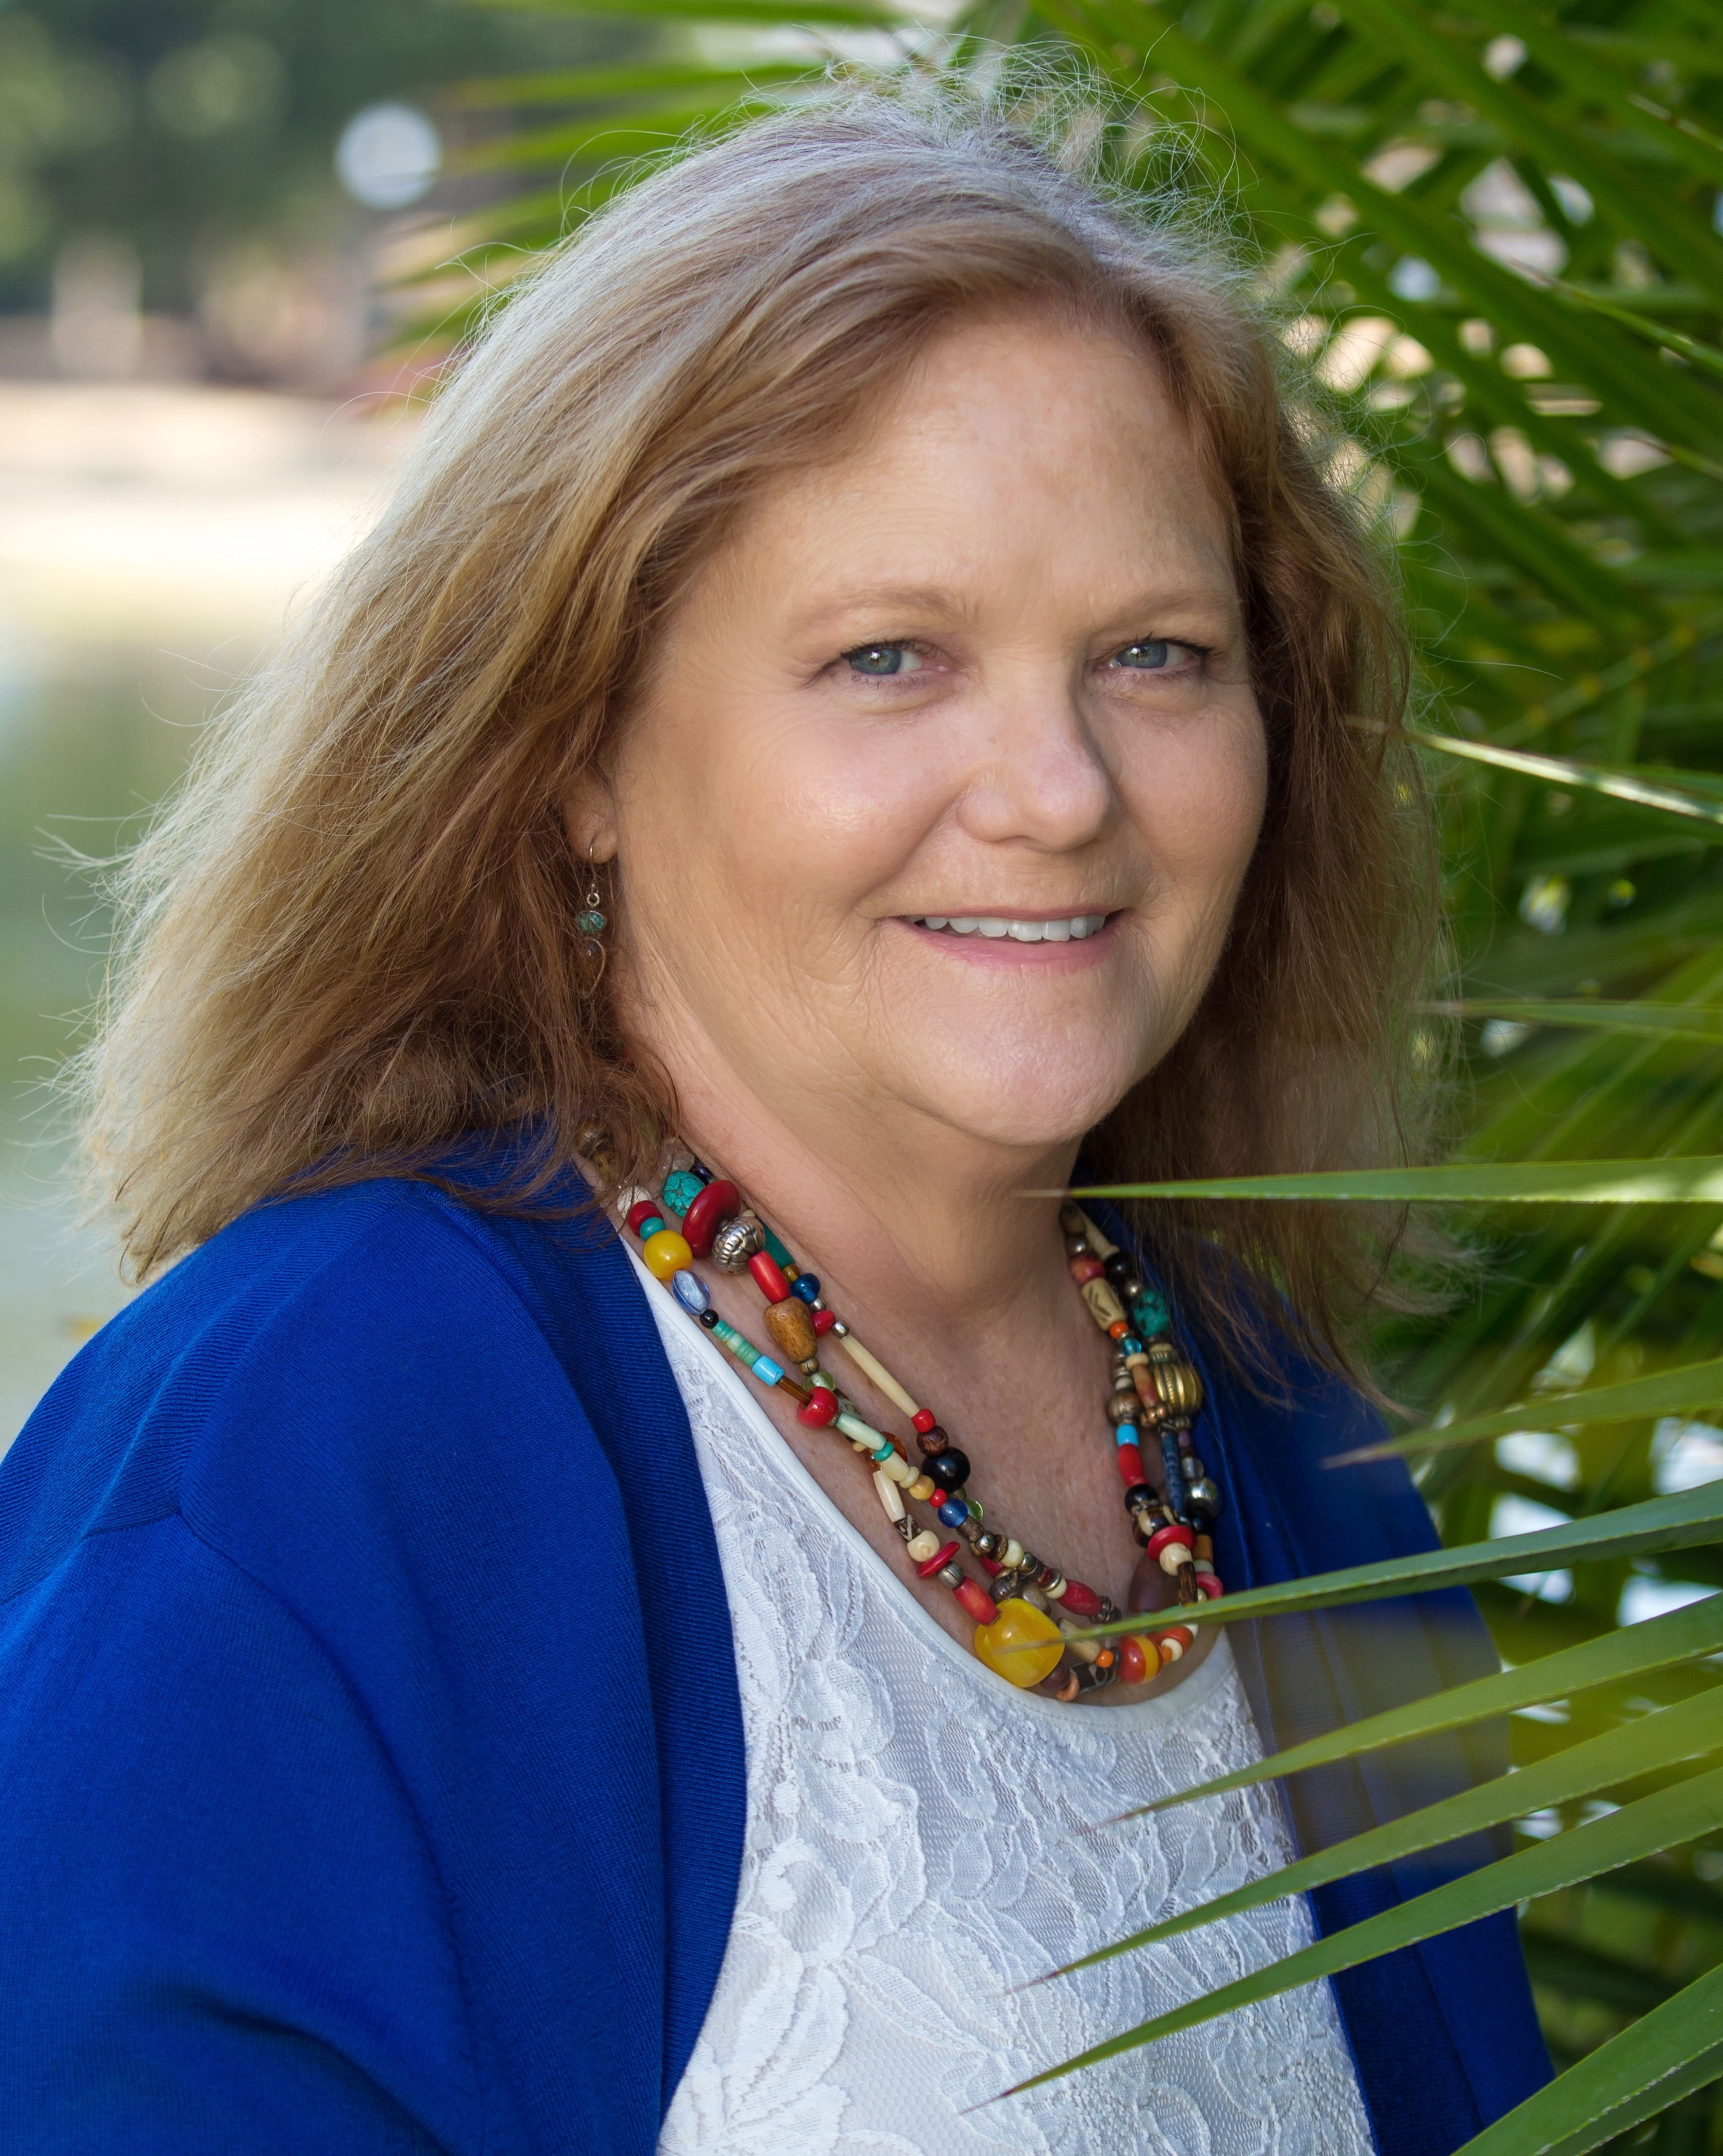
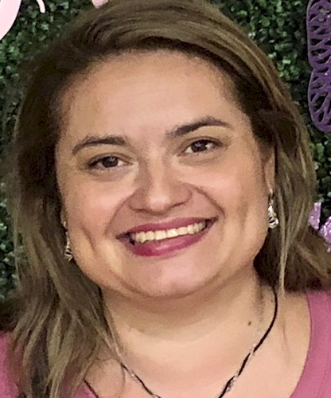
Our coaches are here to help you
Tamra Pauly Elizabeth Cuevas
310-301-2585
Selfdeterminationproject@gmail.com
https://www.edspec.org/transition-to-self-determination
Contact us!
If you want help, please click here to complete a survey so we can get you started

